Slide 1
Detecting Fraudlent Activites using #ML
Team Name : 4Pandas
Team Members:
Anbarasan B(71004)
Arun P(71095)
Rakesh HM(71018)
Ramesh Mari(70631)

Slide 2
About Us
Anbu - I'm a java developer and have a experience of 1 year.
I'm very much interested in coding side as well as working in new technology which is inovative for future generation.
This Hackathon made me to start learning about Pyhton and R-Programming and heartily thanks to Hackathon team for encouraging us.
Arun – Currently I am working on Automation selenium.
- As I started working on automation i was able to understand the future industry and this made me thirst for Machine Learning and R programming,
Rakesh – Currently working on Oracle Database and JAVA.
I like to learn and explore new stuff in tech.
Always there was a part of me, who wanted to change the world and I guess finally with the help of “Hackathone” - #Introduction to #MachineLearning Using #python, this might become true.
Hopefully I continue path accordingly.
Ramesh - Having 3+ years of rich experience in Oracle track,
Before hackthon, I was finding to learn new things, after this hackthon program I am much interested in Python.

Slide 3
Master Data Set
Master Data Set is generated using Java.
Customer ID is generated from 2546001 as reference.
Customer salary is generated using Random function using the salary range provided from use case provided.
MasterDataSet.java provides the Master Data Set for the requirement which contain , [Customer_ID,Customer_Name,Salary]
MasterDataDetails file contains the 100 customer details, [100,3].

Slide 4
Transaction Data Set
Transation DataSet is generated using Java.
GregorianCalendar is used to create the dataset.
Random function is used to generate Random numbers.
Since it is a salary account, it is assumed to credit salary on every 1st of the month.
A random number is picked in a range 25-20 to consider the total transaction of a single Customer per month.
The first transaction of every month is considered as Credit(Salary).
noOfTxnPerMonth = pickedRandomNumber-1(salary);
noOfTxnPerMonth = (Dr+Cr); //Dr = Debit, Cr = Credit
The number of Dr and Cr is again a calculated based on Random Function.
Credit amount is based on their salary.

Slide 5
Implentation Steps:
#Load using Pandas
#Summarise the Dataset
#Visualizing Dataset
#Evaluating my Classifier
#Making Predictions

Slide 6
#Loading my_Dataset
Pandas lib is used for loading datasets in python to manipulate.
#dataset=pandas.csv_read(url)
The above code will read and load the datas.

Slide 7
#Summarising my_dataset
First, get how many instances and attributes are present in my_dataset.
#shape property is used to find dimensions of the my_dataset”
Second,
View my_dataset to see what it actually contains.
#head() property is used to display the datas present in my_dataset
Statistical summary of each attribute (columns)
#“head() property is used to display the datas present in my_dataset
Class Level distribution i.e., number of instances that belong to each class.
#describe() property is used to get count , mean , std , (min to max)
#in our case, there are two class [Debit] and [Credit]”
#this can be done by Groupby(‘class’) method”

Slide 8
#Visualizing my_dataset
For visualizing , we have used both,
Univariate Plot
- Plotting our class (Debit,Credit) [0,1] in #box and whisker plot.
2. Multivariate Plot
- It is mainly used to look at the interactions between the variables.
- In our case, we have used ‘scatter plots’ to spot the structured relationship between input variables., i.e., [Customer_ID,Txn_Amount,Txn_Date,Dr/Cr]

Slide 9
#Evaluating my_Classifier=Decision tree
For our case, to find out fraudulent activities from our ‘txn_dataset’ , we have choosen
Decison tree as Classifier
Reasons for choosing my_classsifier ,
It is not very complex
Easy to understand
Gives better understanding about how the algorithm is implemented to detect fraudulent/abnormal activities.
And there is always a possibility in improving my_classifier in future if wanted.

Slide 10
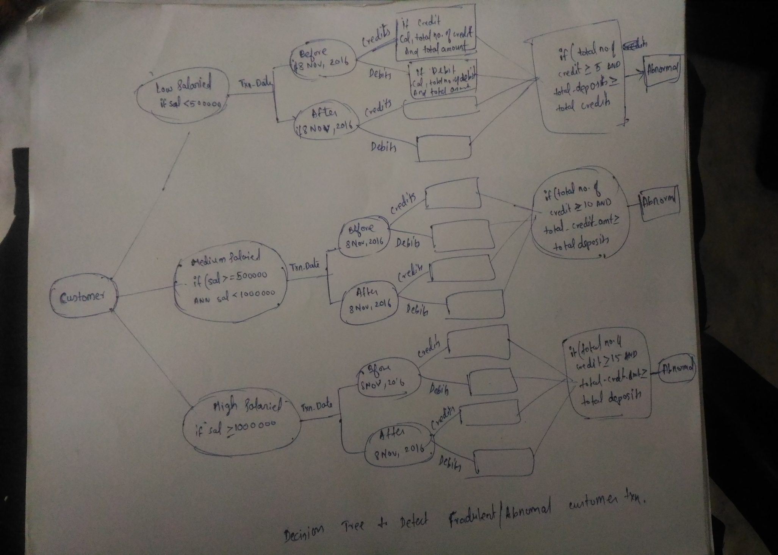

Slide 11
#Making Predictions
Sorry, couldn’t implement this module.
In future, we’ll surely implement and use this project as our base to solve other # MachineLearing Problems.
Thanks You
4Pandas

